Slide 1
Course Overview:
Big Data Analytics

Slide 2
The Topics to be Covered
Chapter 1: Introduction to Big Data Analytics
Chapter 2: Getting to Know Your Data
Chapter 3: Data Preprocessing
Chapter 4: Introduction to the Distributed Platforms & MapReduce
Chapter 5: Finding Similar Items: Locality Sensitive Hashing
Chapter 6: Clustering
Chapter 7: Dimensionality Reduction: SVD & CUR
Chapter 8:Recommender Systems
Advanced topics: applications of big data analytics
  Link analysis
  Mining social network graphs
  Hashing
  Recommender systems
  Large-scale machine learning

Slide 3
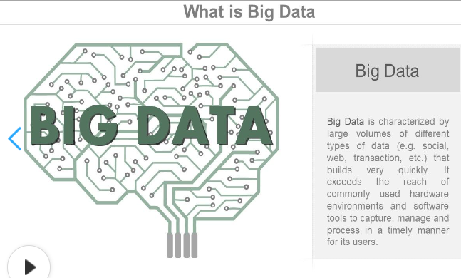
What is Big Data?

Slide 4
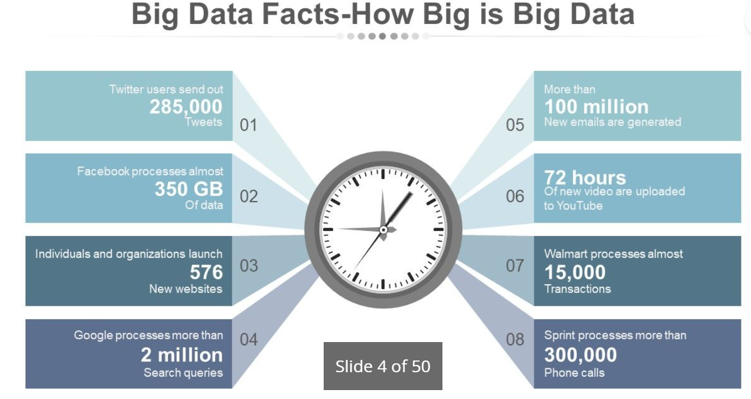

Slide 5
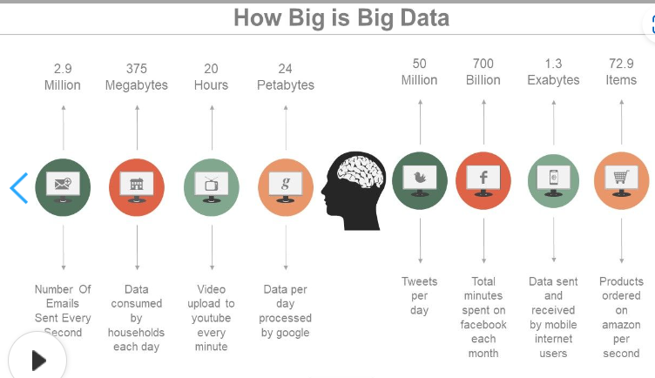

Slide 6
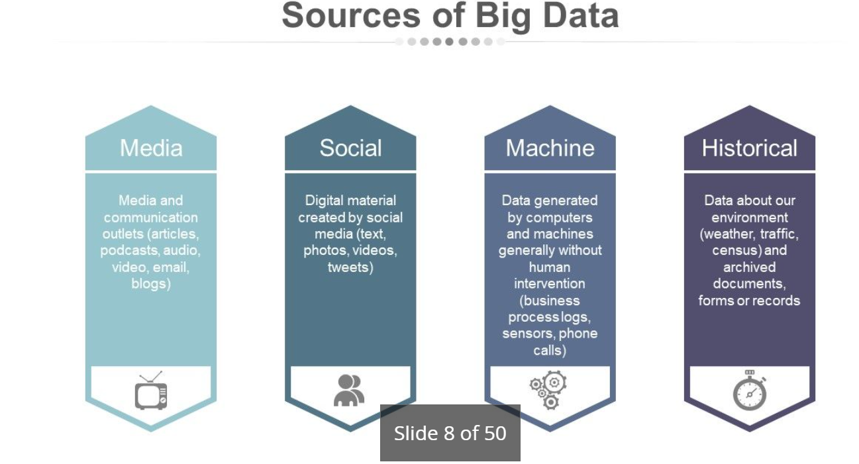

Slide 7
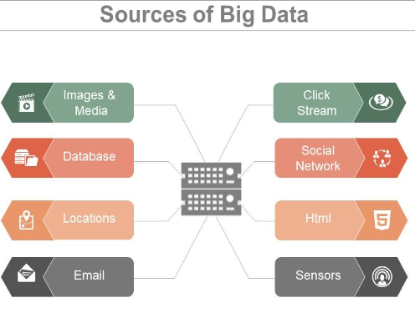

Slide 8
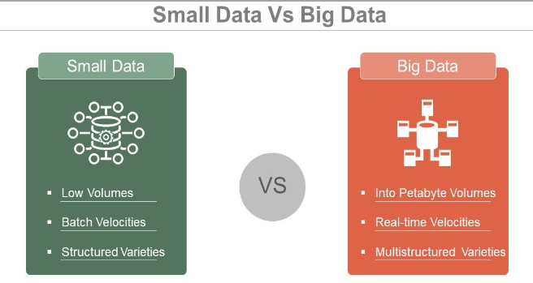

Slide 9
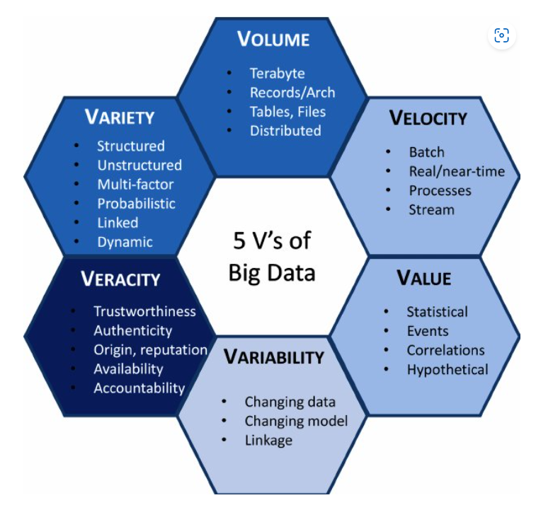
5V’s of Big Data

Slide 10
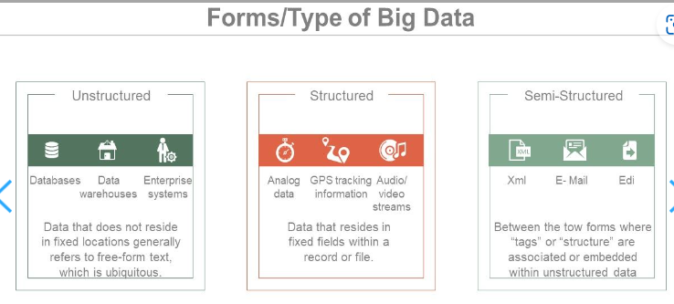

Slide 11
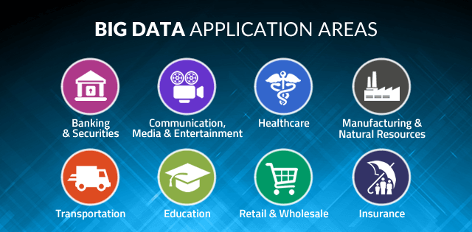

Slide 12
Scalability
CPU: computing time to execute the analysis
I/O: how much data can be put in memory per time unit
Memory: how much data can be processed at a time

Slide 13
Data to be analyzed
Tall data: large number of cases
Wide data: large number of features
Tall and wide data: large number of both cases and features
Sparse data: large number of zero entries

Slide 14
Algorithm to be used
How complex is your algorithm
How many parameters in your model
Are the optimization processes parallelizable
Does your algorithm learn from all data or small batches of data

Slide 15
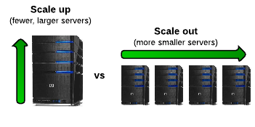
Possible solutions
Scale up: single machine
  More memory, faster CPU, faster storage, using GPUs
  E.g. CUDA, TensorFlow, Keras, …
Scale out: distributing computations
  Using outside resources: other CPUs, GPUs, storage
  E.g. Hadoop, Spark, …
Scale up and out
  Distributed TensorFlow, …

Slide 16
Divide and Conquer
“Work”
Partition
w₁
w₂
w₃
worker
worker
worker
r₁
r₂
r₃
Combine
“Result”

Slide 17
Course Information
Time: Lecture: 2:00-3:20, Saturday.
Classroom: B-701, Next to the Department
Textbook:
  Jure Leskovec, Anand Rajaraman, Jeffrey David Ullman, Mining of Massive Datasets, 2nd Edition, Cambridge University Press, November 2014. (Available at: http://www.mmds.org/) (selected chapters)
Reference book:
  Jimmy Lin and Chris Dyer, Data-Intensive Text Processing with MapReduce, Morgan & Claypool Publishers, 2010. (selected chapters)
Prerequisites:
  Basic knowledge of data structures (and algorithms), database systems, discrete math (probability), linear algebra, and data mining
  Programming experience is *required* for completing homework's & projects

Slide 18
Additional Reading Materials
Books
  Jiawei Han, Micheline Kamber and Jian Pei, Data Mining: Concepts and Techniques, 3rd ed., Morgan Kaufmann Publishers, July 2011.
  Tom White, Hadoop: The Definitive Guide, 4th ed., O’Reilly Media, 2015.
  Holden Karau, Andy Konwinski, Patrick Wendell, Matei Zaharia, Learning Spark: Lightning-Fast Big Data Analysis, O'Reilly Media, January 2015.
Official online documents: Hadoop, Spark, …
Selected academic papers

Slide 19
Grading Policy
Homework assignments and programming exercises: ~30%
Term project: ~30%
  Including proposal, presentation, and final report
Final exam: ~40%
All homework's, projects, and reports must be submitted *before* the end of the semester.

Slide 20
Homeworks and Projects
About 3 programming exercises
  Team-based (<= 2 students per team)
  Analysis on open data set
    E.g. selected datasets from UCI Machine Learning repository, hotspot prediction on taxi data (AIdea), Kaggle…
The term project (to be detailed later)
  Team-based system development
    e.g. extension to exercises
Responsibility of each member must be specified in the document for team-based works

Slide 21
Homework Submission
You will get discounted score when there’s delay in homework submission
  The longer the delay, the higher the discount

Slide 22
Homework Submission
Programs or projects in electronic files must be submitted directly to the zdmossie@gmil.com
  Filename: Compress your source code and related files into one compressed file. Please name it according to your ID and each homework. For example, [id]_HW1.zip, [id]_HW1.tar.gz.

Slide 23
Notes on Homeworks
Rule 1: Plagiarism is strictly prohibited.
  Near-duplicate codes will get equal and minimum basic scores
Rule 2: Clear documentation is required in your system projects.
  Instructions on downloading, installing, configuring, and executing your code and open source library, APIs, or codes must be submitted
  Package control is recommended

Slide 24
About Programming Exercises
For IT students
  Python programming on Spark platform with at least two computer nodes (VMs)
    Or Java/Scala/Python/R programming
    To submit: source code, documentation, and execution result (screenshot or log file showing the analysis result and efficiency)
Be careful about the “big” data size!

Slide 25
The Homework help students:
For IT students, it’s important to get familiar with:
  System structure design and management in cloud computing, or edge computing
    Cloud system architect, cloud analyst, …
  Platform and framework installation, configuration, and big data management (Linux, Hadoop, Spark, …)
    E.g. Server management, data center management
  Parallel programming in distributed frameworks to better utilize more computer nodes
    To make more flexible and powerful analysis possible
  To analyze real “big” data, instead of “toy” datasets

Slide 26
About the Term Project
System development
  For IT students: You can either write your own program, or call existing open source code or library (but NOT only executing existing binary)
    E.g. Hadoop, Spark, TensroFlow, CUDA, …
You are to use *suggested* open datasets in your project
  E.g. UCI Machine Learning repository, kaggle, AIdea, …

Slide 27
More on the Term Project
The score you’ll get depends on the functionality, difficulty, and quality of your project
  System functions and correctness
  Proposals, presentations, and reports are *required* for each team, and will be counted in the score
Tentative schedule for all teams:
  Proposal: *required* after couple of weeks since the start of class.
  Presentations (including demos): *required* in the last one–two weeks
  Final report: *required* before the end of the semester
    Slides, source code, documentation

Slide 28
Some Example Open Source Tools for Big Data Analytics
Apache Hadoop, Spark (in Java, Scala, Python, R)
  For distributed computing and data analysis
Apache Pig, Hive, Flume, Hbase, Cassandra, Alluxio, Mahout, …
  For data flow, SQL, streaming data, distributed databases, distributed storage, machine learning,
Spark SQL, Streaming, Mlib, GraphX
  For SQL, streaming, machine learning, and graph processing

Slide 29
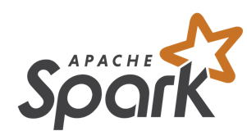
Spark
A general-purpose cluster computing system
It provides high-level APIs in Java, Scala, Python and R, and an optimized engine that supports general execution graphs
It also supports a rich set of higher-level tools
  Spark SQL for SQL and structured data processing
  MLlib for machine learning
  GraphX for graph processing
  Spark Streaming

Slide 30
More Popular Tools
PyTorch
TensorFlow, Distributed TensorFlow
CUDA for GPU processing
…

Slide 31

TensorFlow
An open source software library from Google for high performance numerical computation
  Flexible architecture to deploy computation across a variety of platforms (CPUs, GPUs, TPUs), and devices (desktops, laptops, mobiles)
  Strong support for machine learning and deep learning

Slide 32

Why Python?
One of the most popular interpreted programming languages for building websites
  They can be used to quickly write small programs or scripts to automate other tasks
A large scientific computing and data analysis community
  Improved support for libraries
  Strength for general-purpose software engineering
  Easy to integrate with other codes such as C, C++, Fortran
Suitable for doing research and prototyping, and also for building production systems

Slide 33
Rich Libraries for Data Analysis in Python
Numpy
Scipy
Scikit-learn
Matplotlib
Nltk
…

Slide 34
Some Opinions against Python
Execution speed slower than code in compiled languages such as C++ or Java
  Programmer time vs. CPU time
Challenging for highly concurrent, multithreaded applications
  Global interpreter lock, only one Python instruction executed at a time

Slide 35
Thanks for Your Attention!

